Slide 1

Pennsylvania Chiefs of Police association

Slide 2

The Pennsylvania Law Enforcement Accreditation Program
Accreditation Manager Training (2025)

Slide 3

Partnership
The Pennsylvania Law Enforcement Accreditation Program is partially funded by the Pennsylvania Commission on Crime and Delinquency

Slide 4

Individuals who are:
Prospective Accreditation Manager
New Accreditation Managers
Command Staff and Supervisors
Audience

Slide 5


Slide 6


Slide 7

What will you…
Importance of Accreditation
What is Accreditation
The Role of the Accreditation Manager
How to create, develop, and prepare for an accreditation assessment

Slide 8


Slide 9

Instructor
David Madrak
Upper Dublin Township Police Department
Corporal
Accreditation Manager
Pennsylvania Police Accreditation Coalition
President
Pennsylvania Law Enforcement Accreditation Commission
Assessor
Instructor
Member
Standards Committee
Chairperson

Slide 10


Slide 11

Pennsylvania Law Enforcement Accreditation Program

Slide 12
Accreditation program Overview
When did this start?
What is it?
Why is it important?
Who would want this?
Where can I find help?
When is my agency going to become accredited?

Slide 13

History of Law Enforcement accreditation
Commission on Law Enforcement Accreditation (CALEA) was established in 1979
Approximately 36 “State” Accreditation Programs

Slide 14


Pennsylvania Law Enforcement Accreditation Program

Slide 15
Setting the Standards for Pennsylvania Law Enforcement since 2001
Pennsylvania Law Enforcement Accreditation Commission

Slide 16

In 2000, the Pennsylvania Chiefs of Police Association was awarded funding for the development of a law enforcement accreditation program
Task Force established
Members from each geographic region with various agency sizes represented
Pennsylvania State Police representative
Pennsylvania Police Accreditation Coalition (PPAC) representative
Accreditation Manger representative
Chief of Police from an accredited law enforcement agency
“Wild Card” representatives

Slide 17

Task Force
Named
Service provided by the Pennsylvania Chiefs of Police Association (PCPA)
Specific to law enforcement within the Commonwealth
Initially 108 standards were created
Administrative procedures were created

Slide 18
Pennsylvania Law Enforcement Accreditation Commission (PLEAC)
Serves as the authoritative body that determines whether an agency is worthy of accreditation
Regularly scheduled meetings since September 2000
Consist of members from throughout the Commonwealth
Ralph (Lee) Benson, Chairperson
Numerous sub-committees
Administrative
Assessment
Standards
Strategic Planning

Slide 19

Is my agency required to use PowerDMS?

Slide 20

LAW ENFORCEMENT ACCREDITATION PROGRAM

Slide 21
As of January 23, 2025
Enrolled Agencies
48
Accredited Agencies
184

Slide 22


Slide 23
Accreditation
Established standard of performance, acknowledged business practices, and professionally recognized organizational principles that are mandated as necessary for a particular profession or organization.

Slide 24

What advantages does accreditation provide to my agency?

Slide 25
Credible framework for evaluation of policy and procedure
Highlight agency capability and competency
Improved management procedures
Increased employee morale
Enhanced planning and innovation

Slide 26


Slide 27
Encourages problem solving
Improves law enforcement and community relations
Reduces agency risk and lawsuit exposure
Potential liability insurance savings
Agency accountability
Solid foundation for an agency to build upon

Slide 28

Who does accreditation begin with?

Slide 29

Executive Leadership
Chief of Police
Deputy Chief of Police, Captains, Lieutenants
Municipal administrators
Council, Commissioners, Supervisors
Manager

Slide 30

The application and Chief Executive Officer Responsibilities

Slide 31

What is the cost?
Enrollment
Active PCPA Member - $ 250.00
Non-Member - $500.00
Annually (once accredited)
Active PCPA Member - $ 1,000.00
Non-Member - $1,250.00

Slide 32

Notification to agency personnel - “we’re going for it!”

Slide 33

Agency administration
The Chief Executive Officer and Accreditation Manager are ultimately responsible for the administration of the agency’s accreditation program
Every agency is required to have a designated Accreditation Manager
“New” Accreditation Manager Training Program
Role of Consultants

Slide 34

Who will be my agency’s accreditation manager?

Slide 35
What makes a good accreditation manager?
Interested
Organized
Dedicated
Innovative
Communication skills
Computer skills
Writing skills
Understand the role of “politics” within their agency
Knowledge of Agency Operations

Slide 36
Considerations when selecting an accreditation manager
Nomination Vs. Selection
Volunteer vs. Voluntold
Sworn vs. Non-Sworn
Rank vs. No Rank

Slide 37


Slide 38

Accreditation manager

Slide 39


Slide 40

Is accreditation fun?
IT DEPENDS ON WHAT YOUR DEFINITION OF FUN IS

Slide 41

Culture of the agency
Support of your peers
Your attitude and approach to achieving success
WHAT INFLUENCES YOUR EFFECTIVENESS AS AN ACCREDITATION MANAGER

Slide 42

Make the Most of the Opportunity

Slide 43

1st Step - Training

Slide 44

Responsibilities of the accreditation manager

Slide 45
Responsibilities of the accreditation manager
As each item relates to accreditation
Conducts a “self assessment” of agency
Facility
Policies and procedures
Training

Slide 46
Responsibilities of the accreditation manager
Develops or assists with the development of policies and procedures as they relate to accreditation
Ensures agency compliance with accreditation standards via Proofs of Compliance

Slide 47
Responsibilities of the accreditation manager
Coordinates and facilitates accreditation assessments
Mock
On-site

Slide 48


Slide 49

Self-assessment of the agency
The Longest phase of the Pennsylvania Law Enforcement Accreditation Program

Slide 50
Self- assessment of Agency
Compares agency policy to standards
Creation or revision of policies
Training of personnel

Slide 51
Self- assessment of Agency
Proofs of Compliance are gathered
Forms
Incident or Investigative Reports
Observation

Slide 52
Self- assessment of Agency
Mock Accreditation Assessment
Determines readiness for accreditation assessment

Slide 53

Pennsylvania Law Enforcement Accreditation program
PENNSYLVANIA LAW ENFORCEMENT COMMISSION

Slide 54

Manuals
Acknowledgement
Administrative
Standards
Assessor

Slide 55

Focus areas
Administration Manual
Standards Manual

Slide 56
Administrative manual
Outlines the “rules and regulations” of the Pennsylvania Law Enforcement Accreditation Program

Slide 57
Chapter 1 – Initial steps
Designate an Accreditation Manager
Expect Agency Change
Accreditation Manager Training
Letter of Intent
Application Fee and Annual Program Maintenance Fee
Notification of Personnel
Join the Pennsylvania Police Accreditation Coalition (PPAC)

Slide 58
Chapter 2 – Organization
Organization of Files
Electronic

Slide 59
Chapter 3 – Standards
Standard Categories
Numbering System
Components of the Standard
Standards Containing the Word “If”
Observation Only Files
Standards Not Applicable to Agency
Waiver from Standard Compliance
Sample Assessment

Slide 60
Chapter 4 – Managing, controlling, and Proving Compliance with standards
Create and Implement a Tracking System
Self-Assessment
Cross Compliance and Reference
Compile Supportive Documentation
Train Agency Personnel in Policy Changes
Additions/Updates to Standards
PLEAC/CALEA Dual Accredited Agency

Slide 61
Chapter 5 – Preparing for and conducting a mock on-site assessment
Utilization of a Mock Assessment
Schedule and Host a Mock Assessment
Review Mock Team Findings and Make Amendments
Retrain Employees

Slide 62
Chapter 6 – Preparing for and conducting the on-site assessment
Assessor List
Time Schedule
On-Site Protocol
Meal Schedules
Initial Assessment Preview Files While On-Site
Tour and Static Display
The Assessment Room
Team Leader
Agency Access
Post Assessment
Commission Review

Slide 63
Chapter 7 – Now what?
Accreditation Term
Accredited Agency Logo
Certificate Presentation
Annual Reports
De-certification
Routine File Maintenance
Re-accreditation
Premier Agency Status
Mergers Involving an Accredited Agency
Withdraw From the Program

Slide 64
Glossary & Appendages
Glossary
Appendage A – PLEAC Annual Compliance Survey
Appendage B – PLEAC Department Profile
Appendage C – Audit / Inventory Table
Appendage D – PLEAC/CALEA Crosswalk
Appendage E – PLEAC Best Practices in PowerDMS

Slide 65

How does the process work?
Laws & Regulations –> Policies → Training → Operation of the Agency

Slide 66

Standards Manual

Slide 67

Accreditation Standards
Address high profile and liability related issues

Slide 68


Slide 69
Accreditation Standards
140 total standards
42 – Organization and Management Role
40 – Law Enforcement Function
37 – Staff Support Responsibility
21 – Pennsylvania Legal Mandate

Slide 70
By the numbers
Standards with no bullets = 65
Standards with 2-13 bullets = 75 = 323 bullets
388 Best Practices

Slide 71
Accreditation standards
Organization and Management Role ~ Chapter 1
Law Enforcement Functions ~ Chapter 2
Staff Support Responsibilities ~ Chapter 3
Legal Mandates ~ Chapter 4

Slide 72
Organization and Management
Agency role and responsibilities
Authority
Direction
Planning
Personnel issues
Training

Slide 73
Law Enforcement Function
Patrol
Traffic
Legal Process
Court Security
Sheriff’s Office
Campus Security
College and University Police Departments
Eyewitness Identification
Mobile Recordings

Slide 74
Staff Support
Cells
Temporary Holding
Communications
Records
Property & Evidence Control
Heath & Wellness

Slide 75

Legal Mandates
Crashes
Pursuits
Crime Victims
Missing Persons
Juveniles
Megan’s Law
Training
Domestic Violence
NIBRS, UCR, & ACT 22
Sexual Assault Kits

Slide 76
Numbering System
1st Number = Chapter
2nd Number = Section
3rd Number = Standard within Chapter

Slide 77
Standard Components
Standard Statement
Binding
Narrative Statement
Advisory

Slide 78

Bullets & Sub-Bullets
Require proofs of compliance, unless circumstances dictate otherwise

Slide 79
“If” Standards
Applicable to agency only if…
Conditional

Slide 80

Observation

Slide 81
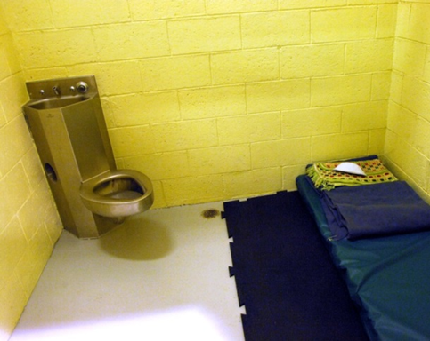
Observation (O)
Select standards
Tour
Checklist
Recommend that photographs are placed into “observational” files

Slide 82
Observations
Facility Tour
Cells (If Applicable)
Communications Center (If Applicable)
Evidence
Temporary
Storage
Impound
Temporary Holding
Static Display
Lethal and Less Lethal Weapons
Specialty Units
Equipment
K-9
Mounted
Specialty Vehicles
ATV
Bicycles
Boat
Motorcycles

Slide 83
Memo-to-file (MTF)
Memorandums
Commonly utilized to demonstrate that none or only one (1) Proof of Compliance is present.
No police officers were hired during the accreditation year
Only one (1) police officer was hired during the accreditation year
May also be used for clarification when Proofs of Compliance require some additional explanation

Slide 84

Interviews
Chief of Police
Evidence Custodians
Internal Affairs
Trainers
Defensive Tactics
Firearms
Less Lethal Weapons

Slide 85

Not applicable (N/A)
Not Applicable if service or function is not available; however not simply because they “don’t do something”
Cells Areas = N/A
Sexual Assault Investigation = Policy required with regards to response until turned-over-to another agency

Slide 86

Now let’s take…

Slide 87

Chapter 1
Standards for Organization and Management Role

Slide 88
Standard Components
Standard Statement:
1.1.1 – A written directive requiring all law enforcement personnel, prior to performing their sworn duties, to take and subsequently abide by an Oath of Office to support, obey, and defend the Constitution of the United States and the Pennsylvania Constitution and the laws of Pennsylvania and the governmental subdivision and that he/she will discharge the duties of the office with fidelity.
Newly hired law enforcement officers, in a manner prescribed by the agency, shall also acknowledge that they will uphold, obey, and enforce the law without consideration to a person’s race, color, sex, religious creed, sexual orientation, age, national origin, ancestry, handicap or disability.

Slide 89
Standard Components
Standard Narrative:
The Oath of Office shall include, at a minimum, the language required by Article VI, Section 3 of the Constitution of the Commonwealth of Pennsylvania. It is essential that all law enforcement officers adhere to an ethical pledge to obey and enforce the law fairly and equally without any other consideration whatsoever. This is the moral obligation that the law enforcement officer makes to the public and for which the officer will be held accountable.

Slide 90
Standard Components
Standard Statement:
1.2.2 – A written directive governing procedures for assuring compliance with all applicable constitutional requirements for in-custody situations, including, but not limited to:
Interrogations
Access to counsel
Search and seizure

Slide 91
Standard Components
Standard Narrative:
Interrogations include interviews, questioning, or any other term used to describe in-custody verbal examinations requiring constitutional rights. These constitutional requirements, federal and state, are vital to the role and function of law enforcement in a free society. By complying with these constitutional requirements, law enforcement officers and law enforcement agencies ensure fair, legal, and equitable treatment of all people.

Slide 92
Standard Components
Standard Statement:
1.2.5 – A written directive that governs the procedures for strip and body cavity searches, for adults and juveniles, that include:
the authority for conducting such searches with and without a search warrant;
privacy provisions with search by same-gender officers;
privacy provisions regarding video recordings during search; and
any required reporting procedures when such searches are conducted.

Slide 93
Standard Components
Standard Narrative:
Strip searches and body cavity searches by law enforcement personnel, even when legally permissible, are controversial. They should be done out of public view, with appropriate regard for the dignity of the suspect, and shall be considered legally necessary and reasonable. When possible, all such searches should be witnessed. With the exception of oral swabs, body cavity searches should be conducted in a hygienic setting and by qualified medical personnel.

Slide 94
Standard Components
Standard Statement:
1.3.11 – A written directive stating that de-escalation strategies will be applied to reduce the need for the utilization of force, when tactically feasible, and providing guidance on those strategies.

Slide 95
Standard Components
Standard Narrative:
Organizational values should reflect preservation of life as a core component. De-escalation policy should be an extension of those values. Policy and training should include concepts such as: Proportionality, recognition of persons in crisis, effective communication skills, and using time and distance to reduce the immediate need for use of force when no immediate threat is imminent. In situations where force could be used, but there is no immediate threat, agencies should encourage the use of other options, as feasible. Where use of force is already in progress, training and policy should address scaling back that use of force as the tactical situation stabilizes, as the resistance of the subject subsides, or as the achievement of positive control of the subject permits.

Slide 96
Standard Components
Standard Statement:
1.9.1 – The agency has a written directive that requires the performance evaluation of all officers and supervisors to be conducted and documented at least annually, including (among other factors):
For officers, an assessment of adherence to agency policies.
For supervisors, an assessment of their effectiveness in ensuring compliance with agency policy, legal requirements, and accreditation standards

Slide 97
Standard Components
Standard Narrative:
Effective supervision and career development is enhanced by a consistently executed evaluation program. Personnel at each level of the agency have different responsibilities. The evaluation programs should address these responsibilities.

Slide 98
“If” Standard components
Standard Statement:
1.10.6 – A written directive requiring that if the agency has a tactical team or members are assigned to and part of a multi-jurisdictional tactical team, negotiators, or animal teams all personnel assigned to those functions:
participate in entry-level basic training prior to assuming those duties;
tactical teams, including assigned negotiators, and canine or mounted teams must train, at a minimum, quarterly; and

Slide 99
“IF” Standard Components
Standard Narrative:
Animals include support/therapy dogs, horses, etc., in which the use requires additional training beyond that of other police officers or incurs additional liability.
It is necessary that specialized training is held at regular intervals and that the training is always documented. Those training records should be retained by the agency due to potential liability that may occur as a result of the actions taken by the team or its members.
If the agency has a tactical team that regularly participates with another tactical team, inter-agency training is encouraged.

Slide 100
Chapter 2
Standards for Law Enforcement Function

Slide 101
Standard Components
Standard Statement:
2.1.1 – A written directive shall be prepared to establish appropriate procedures for responding to calls for service. It shall also include guidelines for the use of authorized emergency equipment that conforms with the provisions of the Pennsylvania Vehicle Code (Title 75) and Pennsylvania Department of Transportation Rules and Regulations, to include:
emergency; and
non-emergency

Slide 102
Standard Components
Standard Narrative:
It is necessary and important that law enforcement agencies classify responses for service according to the seriousness of the call. This will provide guidelines as to when emergency lights and sirens should be used and the method of response to an incident.
Standard also requires information about the responsibilities and duties of the law enforcement officer, the law enforcement supervisor, and the dispatcher during such incidents.
Attention must be given to the applicable provisions of the Pennsylvania Vehicle Code (Title 75) and the regulations of the Pennsylvania Department of Transportation. Consideration must also be given to Chapter 5 of the Pennsylvania Crimes Code (Title 18) in regard to the use of force and deadly force due to recent court decisions involving high-speed police vehicle emergency responses to incidents.

Slide 103
Standard Components
Standard Statement:
2.1.3 – A written directive requiring the agency make available protective soft body armor for all sworn personnel and establishing guidelines for the wearing and availability of those vests during:
assigned uniform field/patrol duty; and (O)
pre-planned, high-risk incidents.

Slide 104
Standard Components
Standard Narrative:
The law enforcement agency is responsible for ensuring that soft body armor or bullet-resistant vests are available for all law enforcement officers. It is potentially as important as the officers’ sidearm.
Such equipment is a necessary item of law enforcement safety equipment. It provides protection from some gunfire and some added protection in motor vehicle crashes.
This requires law enforcement officers to wear protective bullet-resistant vests during high-risk, pre-planned incidents. Due to the nature of these dangerous incidents being known to the agency and its law enforcement officers before a plan is implemented, safety precautions shall be taken.

Slide 105
Standard Components
Standard Statement:
2.2.2 – A directive that details how to access a tactical team

Slide 106
Standard Components
Standard Narrative:
Agencies that do not have an in-house tactical team must have a directive detailing who to contact (State Police, nearby agency, etc.) if a team’s assistance is required. This standard also applies to agencies whose personnel participate in multi-jurisdictional teams.

Slide 107
Standard Components
Standard Statement:
2.5.3 – A written directive prescribing necessary actions at the destination by officer(s) transporting prisoner(s) to any facility other than the agency’s, to include at a minimum:
securing firearms for safekeeping;
removing restraining devices at the time of transfer of custody;
delivering documentation to the receiving officer;
documenting the transfer in a report and/or obtaining a signed receipt for the prisoner, attached to the report; and
advising the receiving personnel of any potential medical or security concerns or hazards posed by the prisoner.

Slide 108
Standard Components
Standard Narrative:
Upon arrival at the destination of the transport, certain actions are necessary and important for public safety, officer safety, and the safety and security of the prisoner. The listed procedures are the responsibility of the law enforcement agency and the completion of them is requirement of the transporting law enforcement officer(s). Necessary exceptions, if desired, to the removal of restraining devices should be provided in the directive.

Slide 109
Standard Components
Standard Statement:
2.7.1 A written directive that includes information regarding each item of legal process, civil and/or criminal, shall be recorded and include, at minimum, the following elements:
date received;
type of legal process, civil or criminal;
nature of the document;
source of document;
name of plaintiff/complainant or name of defendant/respondent;
officer assigned for service;
date of assignment;
court docket number, warrant number, or other identifying number; and
date service is due or date of service.

Slide 110
Standard Components
Standard Narrative:
This system of records should allow entries to be retrieved by docket number, name or unique number assigned to allow cross-reference.

Slide 111
Standard Components
Standard Statement:
2.7.8 – A written directive which:
establishes the process for providing involuntary examinations to suspected mentally ill persons;
ensures initial training is provided to recognize and respond to suspected mentally ill persons;
mandates annual update training in a manner determined by the agency and to include training provided through the course of legal mandate and/or MPOETC regulation, if available; and
if applicable, training on mental health statutes or Department policy changes must be provided within 90 days or as required by statute.

Slide 112
Standard Components
Standard Narrative:
The increasing litigation resulting from encounters by law enforcement with the mentally ill requires agencies to ensure policies, procedures, and training is compliant with current statutes.

Slide 113
Chapter 3
Standards for Staff Responsibilities

Slide 114
Standard Components
Standard Statement:
3.1.2 – A written directive that cells provide the listed minimum conditions for detainees:
adequate lighting; (O)
circulation of fresh or purified air; (O)
availability of a flush toilet; (O)
source of potable drinking water; (O)
access to a wash basin or shower for a detainee held in excess of eight hours;
and (O) bed and bedding for each detainee held in excess of eight hours.
RSESERVED

Slide 115
Standard Components
Standard Narrative:
This standard identifies the required minimum physical conditions that are necessary in order for a law enforcement agency to operate cells.

Slide 116
Standard Components
Standard Statement:
3.1.3 – A written directive requiring the cell area to have an automatic fire alarm, smoke detection system, fire fighting equipment approved by local fire officials, and a written plan prescribing fire prevention practices and procedures to include:
a daily visual inspection of the automatic fire detection devices and alarm systems;
a weekly documented visual inspection of the fire fighting equipment;
an annual documented testing of fire fighting equipment; and
required documented testing of the automatic fire detection devices and alarm systems, annually, or in accordance with the law and local fire code regulations.

Slide 117
Standard Components
Standard Narrative:
The cell area must have an automatic fire, and smoke detection system. Appropriate fire suppression equipment must also be available in the cell area in case of fire.
A written plan is required which prescribes necessary emergency procedures and fire prevention practices.
All fire prevention and fire suppression equipment needs to be inspected as required by local and state fire regulations. Drills should also be conducted to ensure that the procedures are adequate and that agency personnel are prepared to respond and handle any fire emergency that may occur in the cell area.

Slide 118
Standard Components
Standard Statement:
3.1.11 – A written directive requiring that an intake form, developed by the agency, shall be completed for every person booked into the cell and that it contains at least the following information:
personal identification information;
arrest information;
property inventory and disposition;
current health of the detainee;
medications taken by the detainee;
behavior, involving state of consciousness and mental status; and
anybody deformities, trauma markings, bruises, etc.

Slide 119
Standard Components
Standard Narrative:
A formal intake process is necessary in order to manage a cell. An intake form must be completed for each person detained in the facility. Certain information must be documented as determined by the agency.

Slide 120
Standard Components
Standard Statement:
3.1.3 – A written directive addressing the following security concerns in the temporary holding area:
weapons control;
panic or duress alarms;
method of access to area and prisoner for alarm responders;
escape prevention;
search of detainee;
security inspection;
detainee shall be physically attended; however
the detainee may be left unsupervised for a period of no longer than 10 minutes when secured.

Slide 121
Standard Components
Standard Narrative:
These are safety and security concerns for the agency when a temporary holding area is used.

Slide 122
Standard Components
Standard Statement:
3.5.1 – A written directive that requires designated personnel to be available on a 24-hour basis to process crime scenes, traffic crash sites, and other investigation scenes.

Slide 123
Standard Components
Standard Narrative:
This requires that the law enforcement agency have the availability of qualified personnel to process crime scenes, vehicle crash scenes, or other investigation scenes on a 24-hour basis. Those individuals, whether from the law enforcement agency or from another law enforcement agency, will respond to the scene of those incidents to collect and preserve evidence for the agency and its personnel.

Slide 124
Chapter 4
Pennsylvania Legal Mandates

Slide 125
Standard Components
Standard Statement:
4.2.2 – A written directive describing the circumstances warranting the use of special stopping techniques which specifies the procedures for correct implementation:
immobilization devices;
stopping techniques; and
initial training and in-house refresher training at least once every three years.

Slide 126
Standard Components
Standard Narrative:
All such methods should only be used with the utmost level of care and caution. Their use may constitute the use of deadly force in the apprehension of the violator based on recent court decisions.

Slide 127
Standard Components
Standard Statement:
4.2.3 – A written directive establishing:
the procedures for reporting and an in-house administrative review of the pursuit;
policy training (review) by affected personnel at least once per accreditation cycle.

Slide 128
Standard Components
Standard Statement:
4.4.1 – A written directive requiring that all persons arrested for felony, misdemeanor, and escalating summary offenses shall be fingerprinted.

Slide 129
Standard Components
Standard Narrative:
Section 9112 of the Pennsylvania Crimes Code (Title 18). The importance of fingerprinting all persons arrested cannot be overstated. All persons shall be fingerprinted regardless of the disposition of the charge or status of the case. All prints shall be forwarded immediately to the PA State Police repository. A 100% compliance rate should be the target of all agencies.

Slide 130
Standard Components
Standard Statement:
4.12.1 – A written directive stating the agency must comply with the requirements of Uniform Crime Reporting Acts, as applicable, requiring all Commonwealth law enforcement agencies to report crime statistics to the Pennsylvania State Police.

Slide 131
Standard Components
Standard Narrative:
Agencies shall submit applicable crime statistics on a monthly or yearly basis as required by statute.

Slide 132
Standard Components
Standard Statement:
4.14.1 – The agency must have a directive addressing the requirement of the Sexual Assault Testing and Collection Act (SATEC) 35 P.S. ss 10172.1 – 10172.4, Act 29 of 2019.
Agency shall take possession of Sexual Assault Kits within 72 hours of being notified of its existence.
For those cases in which the victim or a victim advocate acting at the victim’s direction has provided written notice of consent to the forensic testing, the law enforcement agency must submit evidence awaiting testing to an approved laboratory within 15 days.
For those cases in which the victim has not provided consent to testing, the evidence must be preserved and stored for a period of no less than the statute of limitations, unless consent is provided before that period.
The SAK shall be stored in compliance with policy developed as per the Act.
Reports must be filed as per requirements of the Pennsylvania State Police. (04/19)

Slide 133
Standard Components
Standard Narrative:
Act 29 of 2019 was enacted in order to address the nationwide backlog of untested Sexual Assault Kits often referred to as “Rape Kits”.

Slide 134

Standards
New standards are effective within six (6) months of release, typically October 1st
If you are a new agency seeking accreditation or an agency seeking re-accreditation, and the scheduled on-site accreditation assessment is within that six (6) month time frame then the agency is NOT responsible for adopting the new standards until after the assessment is completed
Standards Committee

Slide 135

Helpful tips

Slide 136
Organization of Files
Agency visits
Others
Awareness
Tracking
Actions
Activities
Training
Innovation
Own
Files
Facilities

Slide 137

Cells vs. Temporary Holding
Property & Evidence Control
Temporary Evidence
Bicycles
“Found Property”

Slide 138
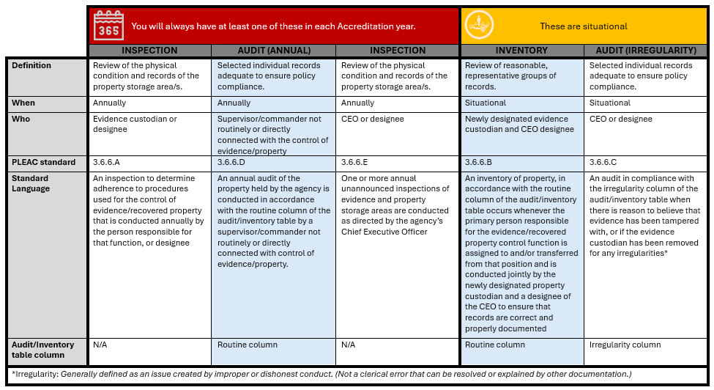
Compliments of Sgt. Jared Hahn

Slide 139

What should the format of a policy look like?

Slide 140

Outline
Header
Statements
Policy
Purpose
Procedures

Slide 141
Header – Required components
Name of Agency
Name & Number of Policy
1.2.5 – Strip & Body Cavity Searches
Effective Date
Review or Revision Date
Chief Executive Officer’s Name
Electronic Signature is acceptable

Slide 142

Written directives
Need to “match” or “mirror” the standard

Slide 143

“I’ve begun writing a new policy manual; I have the pages numbered, now all I must do is fill in the rest!”

Slide 144

where can I locate a "good” policy or proof of compliance?

Slide 145

Resources
Sample Assessment
Power DMS – Pennsylvania Chiefs of Police Association
https://powerdms.com/ui/login.aspx?formsauth=true
After enrollment in the Accreditation Program
Accredited agencies
Agency’s insurance provider
Professional services (Consultants)

Slide 146

Do your Agency’s policies or proofs of compliance “Meet the mark”?

Slide 147

“Countless unseen details are often the only difference between mediocre and magnificent.”

Slide 148
What does my agency have to prove?
Standard
Policy
Proofs of Compliance
Must demonstrate compliance with the standard, unless agency policy is more restrictive, in which case the policy requirement must be proved

Slide 149
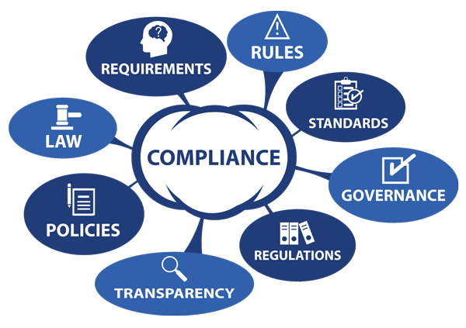
Proving compliance
Compliance needs to be demonstrated through:
Written Directive
Policy = Standard (to include bullets)
Written Documentation
Form, Incident or Investigative Report, Observation

Slide 150
Written Documentation (AKA – Proofs of Compliance)
Certificates
Emails
Forms
Interviews (Limited Basis)
Incident & Investigative Reports
Lesson Plans
Memorandums (Memo-to-File)
Observation
Video

Slide 151

Initial Accreditation
Proofs of compliance should be within 12 months of the assessment; however, they can be up to 18 months from that date if necessary

Slide 152

Policies and Proofs of compliance need to be adequate to satisfy the assessor

Slide 153

Mock assessment procedures

Slide 154

An Esteemed organization

Slide 155
What is PPAC?
Membership
Executive Board
David Madrak, President
Ryan Cywinski, Vice President
Michael Piacentino, Treasurer
David Kostiak, Recording Secretary
Dues
Discounts available
Website
www.papac.org
Monthly Meetings
Schedule
Minutes
A PROFESSIONAL ORGANIZATION

Slide 156

Mock Accreditation Assessment

Slide 157
What is a “Mock”?
“Informal Assessment”
Arranged at agency discretion; however, preference is through the Pennsylvania Police Accreditation Coalition (PPAC)
Cost
“Find what is wrong”
Invoiced if not a PPAC member
Paid for via membership dues to PPAC

Slide 158
When is a Mock Assessment Required?
Initial Accreditation evaluation
Change in the Accreditation Manager
New Chief Executive Officer for the agency
Any period in which the agency request a 6-month extension
Any period in which the agency moved to a new facility or made substantial changes to the existing facility

Slide 159

Who conducts An Agency’s mock accreditation assessment?

Slide 160

Assessors!

Slide 161
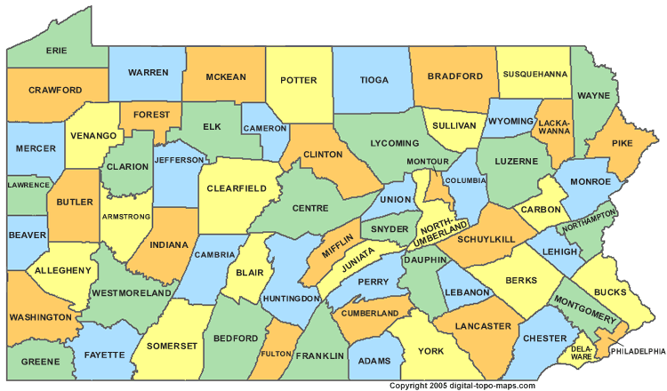
Where are the mock assessors from?
Four (4) current or accreditation managers from local police departments
Northeast
Southeast
Central
West

Slide 162

How do I schedule a mock?
Registration
Complete the form on the website
www.papac.org

Slide 163

Questions Concerning a mock?
Contact a Mock Coordinator
Southeast Region
David Madrak, Corporal @ Upper Dublin Township Police Department
215-646-2101 or david.madrak@udpd.us
Northeast Region
Ryan Cywinski, Sergeant @ Hanover Township Police Department
570-825-1254 or rcywinski@hanovertwppd.org

Slide 164


Questions Concerning a mock?
Contact a Mock Coordinator
Central Region
April Knerr, Patrol Officer, @ Allentown Police Department
610-439-5961 or april.knerr@allentownpa.gov
Western Region
Jason Hendershot, Chief of Police @ Clarion University Police Department
412-268-6232 or jhendershot@pennwest.edu

Slide 165

What is the cost of a mock?
Minimal
Meals
Breakfast (if on-site)
Lunch (if on-site)
Transportation
Extreme circumstance
Hotel
Extreme circumstance

Slide 166
Mock coordination & Reporting
Agency’s Point-of-Contact & Mock Accreditation Team Leader
Team Leader will complete a report (i.e. email, letter, and/or Power DMS report or paper file worksheets and provide this to the agency’s Point-of-Contact and the Pennsylvania Chiefs of Police Association (PCPA) staff

Slide 167
Outcome of mock accreditation assessment
Feel free to ask if a mock accreditation assessment took place; however, the agency determines on their own if they will have a mock accreditation assessment
If a mock accreditation assessment did take place, do not seek additional information
Remember a mock accreditation assessment is strongly recommended for every agency, but not required

Slide 168
Accreditation Assessment Procedures

Slide 169

What is your plan?

Slide 170

Accreditation Assessment
Accreditation Assessment
Average of one (1) or two (2) day(s)
Success oriented
Accreditation Team
Two (2) or more Pennsylvania Chiefs of Police Association trained accreditation assessors
Selected from outside of local geographical area

Slide 171

How do I schedule an accreditation assessment (On-site)?
Contact the Sara Feaser @ Pennsylvania Chiefs of Police Association
A minimum of six (6) weeks notice is required
May schedule before the mock accreditation assessment; however, if this is the case, you may have waited too long to schedule the mock!
Both the Chief of Police and the Accreditation Manager must be available

Slide 172

Scheduling Your agency’s accreditation assessment
60 days prior to on-site in order to ensure time is available to correct any issues that arise from the mock accreditation assessment. In no case would anything less than 30 days be recommended.

Slide 173

How will we ever do this?

Slide 174
Contact & Planning
Accreditation Manager
Contact and discuss with the Team Leader:
Arrival date and time
Daily begin and end times of assessment
Food
Tour of Facility
Static Display
Ride-Along
Interview of the Chief Executive Officer
“Exit” interview
Departure

Slide 175

Prepare employees
Staff
Spotlight agency “stars”
Keep them involved and updated accordingly
Recommend that agency “nay-sayers” are not involved

Slide 176

Demeanor & bearing of Self and agency personnel
Sleep and be well rested
Be prepared
Consistency in appearance
Professionalism

Slide 177
Assessor Workspace
Room
Private
Telephone
Electrical outlets
Extension cords
Internet access
Supplies
Paper
Pens

Slide 178

Assessor Workspace
Resources
Annual Report
Organizational Chart
Crimes Code
Collective Bargaining Agreement

Slide 179

Assessor Workspace
Reasonable access to the accreditation manager

Slide 180

Hospitality

Slide 181
Professional ethics
Gesture
Coffee Cup
Patch
Pen
Meals
Optional (not required), but strongly encouraged; presents an opportunity to network with other law enforcement professionals

Slide 182


Slide 183
Duration of on-site
Initial Accreditation Assessment = 2 days
Re-Accreditation Assessments = 1 or 2 Day(s)

Slide 184
Compliance verification
Facility Tour
Static Display
Interviews
File Review
Paper
Power DMS

Slide 185

Day 1 and/or 2
Escort to agency
Introductions to Stakeholders
Facility Tour
Static Display
Interviews
File Review
Ride-Along

Slide 186
File review
Initial & Re-accreditation Assessments
Select files will be accessed before arrival at the agency (reference the Administrative Manual for more information)

Slide 187

Tour Sheet
Customized specific to your agency
Organized to the layout of your agency’s facility

Slide 188
Observations
Facility Tour
Cells (If Applicable)
Communications Center (If Applicable)
Evidence
Temporary
Storage
Impound
Temporary Holding
Static Display
Lethal and Less Lethal Weapons
Specialty Units
Equipment
K-9
Mounted
Specialty Vehicles
ATV
Bicycles
Boat
Motorcycles

Slide 189
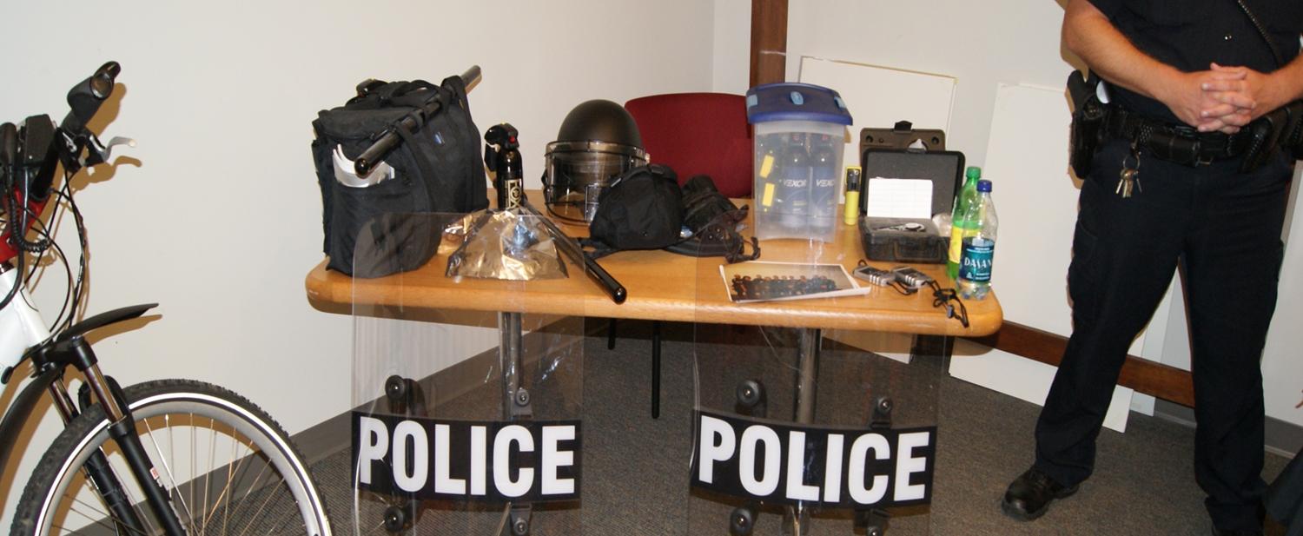
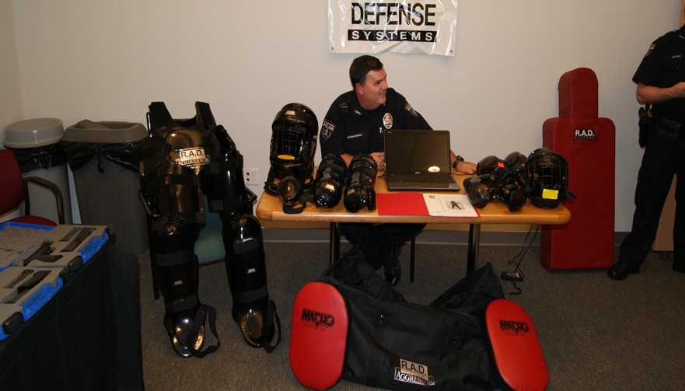
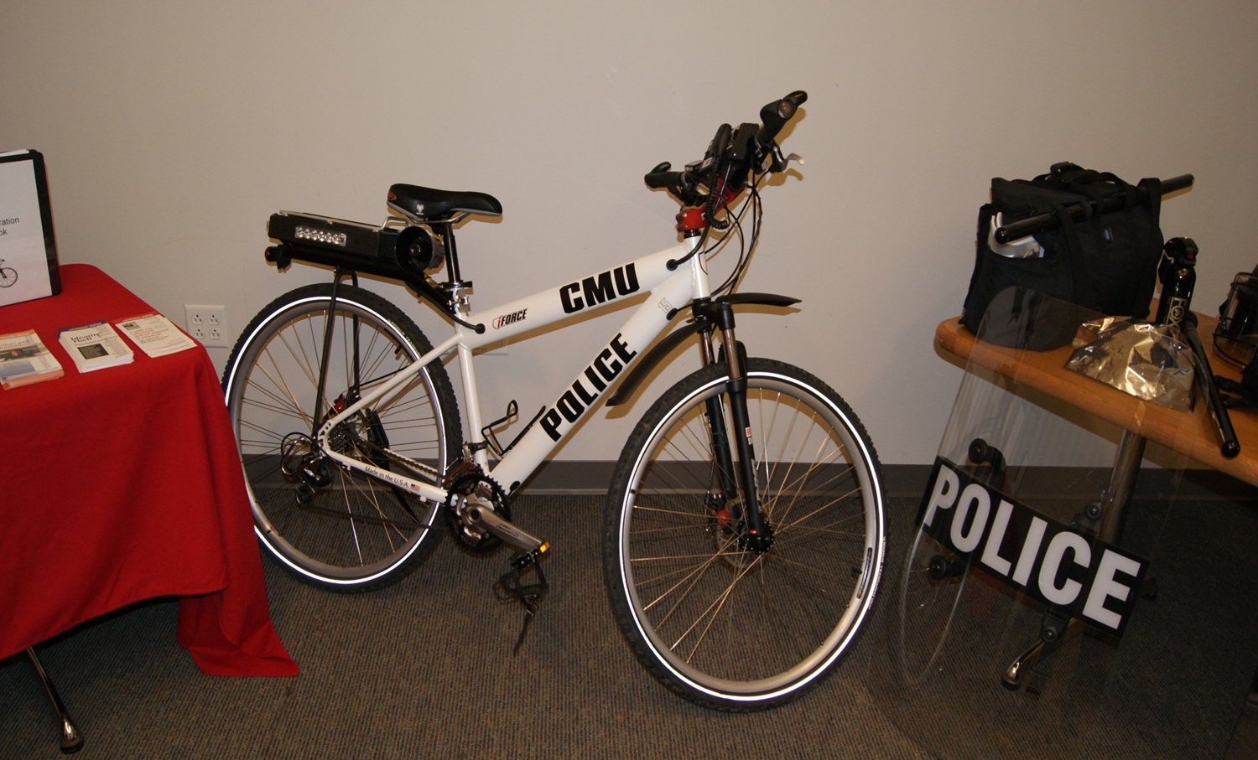
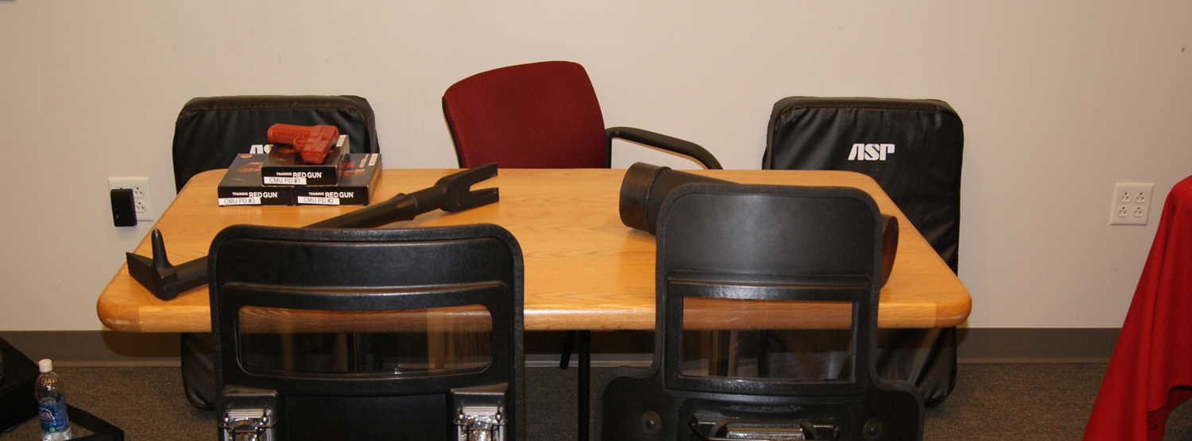

Slide 190

Ride-along
Focus on compliance and corroborate what was found in the file review
Attempt to determine if the officer assigned understands some of the high liability core critical tasks that there are standards on
Ride-along report should reflect same; biography of the officer assigned is not necessary

Slide 191
“Exit” Interview
Audience
Determined by the Chief Executive Officer
Each assessor discusses points of interest or concerns
Team Leader discusses adjustments or recommendations
Will not confirm “Pass/Fail”

Slide 192

Assessors

Slide 193

Prior to arrival @ Agency
Team Leader will assign chapter(s) to assess
Possession of a laptop
Review
Agency Profile
Website
Annual Report (if provided)

Slide 194

Files

Slide 195

Simple note
If file is not immediately compliant, reason(s) documented with a Simple Note in PowerDMS or on Assessor worksheet; upon corrections being made, note is updated, NOT DELETED

Slide 196

Remember
The focus is on meeting the Standard, NOT liking their written directive / policy
Suggestions can be made for improvement but if directive meets the standard, can only suggest

Slide 197

Conflict Resolution
Early resolution is imperative
Team Leader -> Accreditation Manager
Team Leader -> Chief Executive Officer
Team Leader -> Accreditation Coordinator for PCPA

Slide 198

Issues
The Team Leader must be notified of any issue that could lead to a Non-Compliant file
All assessors must reach a consensus on determining if a standard will be deemed non-compliant
If an Accreditation Manager does not agree with an assessor, the issue should be turned-over-to the Team Leader, if not already involved

Slide 199


Slide 200

Make it reasonable to:
Follow
Read
Understand
Find information

Slide 201



Slide 202


Slide 203

INTERPRETATION OF A STANDARD & THE USE OF A PARTICULAR PROOF OF COMPLIANCE

Slide 204


Slide 205
Possibilities
Accreditation
Provisional Accreditation
No
Neutral

Slide 206

Success oriented but not a “rubber stamp.”
Assessors should attempt to work with an agency, but it is the responsibility of the agency to do the work, not the assessor.
Is a cooperative effort between the agency and assessors to work together toward the goal of achieving accredited status for the agency

Slide 207

Assessment & Compliance
Responsibility of the Team Leader
Focus of Assessment Team Report
Brief history of agency is permissible
Submitted to Accreditation Program Coordinator within 15 days of the accreditation assessment

Slide 208

Award Date
Current Certificate
Date listed
Initial Accreditation Assessment
Date of last day of on-site

Slide 209

Accreditation Requirements
Valid for 36-months
Awarded by the Pennsylvania Chiefs of Police Association
Re-assessment required to maintain status
Annual Compliance Survey

Slide 210

Annual Compliance Survey
Required in order to maintain accredited status
Calendar reminder; its is not the responsibility of PCPA to notify you of its due date
Within 30 days of anniversary date, no earlier

Slide 211

What resources are available to help guide me through this process?

Slide 212


SAMPLE Assessment

Slide 213
Sample Assessment
Created by PLEAC
Questions
Recommendations
Purpose
Assist
Accreditation Managers
Assessors
“Living” documents
Continuously updated

Slide 214
Access to the Sample assessment
Contact Sara Feaser at the Pennsylvania Chiefs of Police Association
Must be enrolled in the accreditation program or an accredited agency
www.powerdms.com
Site Key
Username
Password

Slide 215
What does the Sample Assessment typically consist of?
Proofs of Compliance
Notes
How proofs are to be shown
Address specifc issues

Slide 216

Resource Guide
Formerly known as the Best Practices Guide

Slide 217


Slide 218


Slide 219
Initial Accreditation
The Chief Executive Officer, or their designee, and the Accreditation Manager must attend the scheduled Pennsylvania Law Enforcement Accreditation Commission meeting in which their initial accreditation report will be read, reviewed and considered by the Pennsylvania Law Enforcement Accreditation Commission

Slide 220
Consent agenda
The Pennsylvania Law Enforcement Accreditation Commission uses a Consent Agenda method to vote on routine re-accreditations.
A member can object to one or more reports being considered on the Consent Agenda, the report will be removed and placed on the regular agenda.
When this occurs the Chief Executive Officer, or their designee, and the Accreditation Manager must attend the scheduled Pennsylvania Law Enforcement Accreditation Commission meeting

Slide 221
Extensions
A single six (6) month extension is permitted and can be authorized by the Accreditation Program Coordinator
The request must be made in a timely manner to allow for adequate review
Only one (1) extension may be granted per accreditation cycle

Slide 222
Extensions
Any subsequent extensions in future assessments must be sent to the Accreditation Program Coordinator who will forward them to the Pennsylvania Law Enforcement Accreditation Commission for review
The Chief Executive Officer, or their designee, and the Accreditation Manager must attend the next scheduled Pennsylvania Law Enforcement Accreditation Commission meeting when the extension request is on the agenda

Slide 223
Extensions
Your initial assessment date remains your agency’s re-accreditation date, even with an extension and a successful re-accreditation

Slide 224
Waiver from compliance
Waiver available for two (2) different reasons:
Compliance must be IMPOSSIBLE:
Conflict with Collective Bargaining Agreement
Local Ordinance
NOT because an agency does not want to have to address it

Slide 225
Waiver from compliance
Request for Waiver submitted to Accreditation Program Coordinator before assessment
The Chief Executive Officer, or their designee, and the Accreditation Manager should plan on attending the next scheduled Pennsylvania Law Enforcement Accreditation Commission meeting when the waiver request is on the agenda
It may take as many as 90 days for approval/denial

Slide 226
Mergers
There may be times when accredited law enforcement agencies are merged to operate under a single Chief Executive Officer and a single policy manual
These mergers may involve accredited and non-accredited agencies
Four (4) options available to these agencies
Reference the Administrative Manual for more information

Slide 227
Yearly review
Standards and their subsequent requirements are reviewed, revised, and in some cases reinterpreted for clarification every year, though sometimes more often.
How do you find out?
Pennsylvania Police Accreditation Coalition
PA Chiefs Power DMS Sample Assessment

Slide 228

Final Thought

Slide 229
Who to contact
James Adams
Accreditation Program Coordinator
jadams@pachiefs.org
Sara Feaser
Accreditation Administrative Assistant
sfeaser@pachiefs.org
www.pachiefs.org

Slide 230


Slide 231


